Slide 1

Ahmednagar Jilha Maratha Vidya Prasarak Samaj`s
NEW ARTS,COMMERCE AND SCIENCE COLLEGE,AHMEDNAGAR
DEPARTMENT OF STATISTICS
2019-20
A PROJECT REPORT ON
Statistical Analysis Of Nutrition Data
Using Machine Learning Techniques
Submitted By
Bankar Vaishnavi Vilas
Jadhav Smita Balasaheb
Labade Snehal Shivaji
Under The Guidance Of
Prof. Dr.A.A. Kulkarni mam

Slide 2
Introduction
Here, variable Energy is depend on different nutrients also on different food groups.
Good nutrition is fundamental for good health and the prevention, treatment and management of the disease.
Healthy nutrients means eating a variety of foods that gives you the nutrients need to maintain your health, feel good, and have energy.
Eating a variety of fruits and vegetables provide different nutrients.
Different types of food groups have different amount of vitamins, proteins, folate, zinc, copper etc. and our energy intake is depend on that different types of nutrition.
If the quantity of that nutritional contains change amount of energy also change.
Data Description:
Variables: Energy , Food Group, Protein , Fat , Carbohydrate, Sugar Fiber, VitaminA , Vitamin B6, Vitamin B12, Vitamin C ,Vitamin E, Folate, Niacin , Zinc ,Riboflavin, Thiamin , Calcium, Copper, Iron ,Magnesium, Manganese, Phosphorus, Selenium.
Food Groups :American India/Alaska Native foods, Baby foods, Baked Products, Beef products, Beverages, Breakfast Cereals, Cereal Grains and Pasta, Dairy and Egg products, Fruits and fruits juices, Lamb, veal, and game products, Legumes and legumes products, Meals Entrees and side dishes, Nut and Seed products, Pork Products, Poultry Products, Restaurant foods, Sausages and Luncheon Meats , Snacks,soups, Sauces and gravies, Spices and herbs,Sweets, Vegetables and Vegetable products

Slide 3
Reference values Men
Age | 11-14 | 15-18 | 19-24 | 25-50 | +51
Protein(g) | 45 | 59 | 58 | 63 | 63
VitaminA(ug) | 1000 | 1000 | 1000 | 1000 | 1000
VitaminB6(ug) | 1.7 | 2 | 2 | 2 | 2
VitaminB12(mg) | 2.0 | 2.0 | 2.0 | 2.0 | 2.0
Vitamin C(mg) | 50 | 60 | 60 | 60 | 60
Folate(ug) | 150 | 200 | 200 | 200 | 200
Niacin(mg) | 17 | 20 | 19 | 19 | 15
Riboflavin(mg) | 1.5 | 1.8 | 1.7 | 1.7 | 1.4
Thiamin(mg) | 1.3 | 1.5 | 1.5 | 1.5 | 1.2
Calcium(mg) | 1200 | 1200 | 1200 | 800 | 800
Iron(mg) | 12 | 12 | 10 | 10 | 10
Magnesium(mg) | 270 | 400 | 350 | 350 | 350
Phosphorous(mg) | 1200 | 1200 | 1200 | 800 | 800
Selenium(ug) | 40 | 50 | 70 | 70 | 70
Zinc(ug) | 15 | 15-18 | 15 | 15 | 15
Sugar(gm) | 37.5 /day
Fiber(gm | 30 to 38/day

Slide 4
Women
Age | 11-14 | 15-18 | 19-24 | 25-50 | +51
Protein(g) | 46 | 44 | 46 | 50 | 50
VitaminA(ug) | 800 | 800 | 800 | 800 | 800
VitaminB6(ug) | 1.4 | 1.5 | 1.6 | 1.6 | 1.6
VitaminB12(mg) | 2.0 | 2.0 | 2.0 | 2.0 | 2.0
Vitamin C(mg) | 50 | 60 | 60 | 60 | 60
Folate(ug) | 150 | 180 | 180 | 180 | 180
Niacin(mg) | 15 | 15-18 | 15 | 15 | 13
Riboflavin(mg) | 1.5 | 1.8 | 1.7 | 1.7 | 1.4
Thiamin(mg) | 1.3 | 1.3 | 1.3 | 1.3 | 1.3
Calcium(mg) | 1200 | 1200 | 1200 | 800 | 800
Iron(mg) | 15 | 15 | 15 | 15 | 20
Magnesium(mg) | 280 | 300 | 280 | 280 | 280
Phosphorous(mg) | 1200 | 1200 | 1200 | 800 | 800
Selenium(ug) | 45 | 50 | 55 | 55 | 55
Zinc(ug) | 12 | 12 | 12 | 12 | 12
Sugar(gm) | 25 /day
Fiber(gm) | 21 to 25 / day

Slide 5
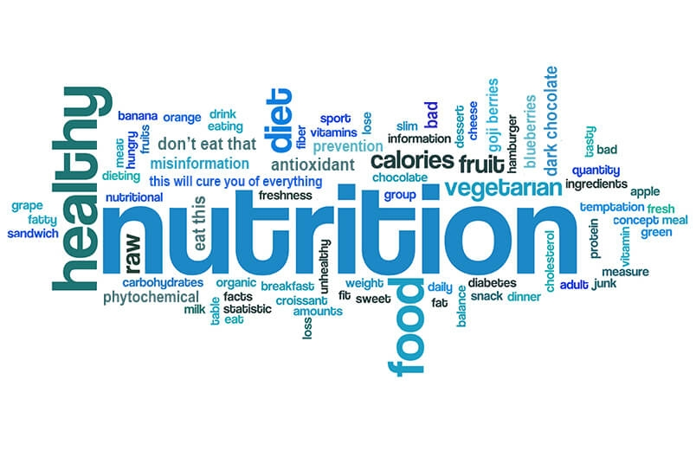
Objectives
The objectives behind the study are
To study the relationship between the response Energy_kcal and other independent variables.
To study the which variables are important to increase the amount of energy.
To study the which food groups provides the sufficient amount of energy to maintain our health.

Slide 6
Tools And Techniques
R- Software
Supervised Machine Learning Algorithm
1. Multiple Linear Regression
2.Random Forest Regresion
3.Support Vector Regression
Unsupervised Machine learning
1. K- Means Clustering
Excel
Data Visualization

Slide 7
Graphical Representation of average Energy of different food groups
From the above plot we can see that food group Fats and Oils contains more amount of energy.

Slide 9
Multiple Linear Regression
Residual standard error: 14.73 on 5985 degrees of freedom , Multiple R-squared: 0.9924, Adjusted R-squared: 0.9924 F-statistic: 1.709e+04 on 46 and 5985 DF, p-value: < 2.2e-16
Interpretation: Here Food Groups Beverages, Breakfast cereals, Fats and oils, Fruits and Frui Juices, Nut and seed Products, Soups Sauces and gravies, Sweets and vegetable and vegetable products are significant that means they are important to increase the amount of Energy. Protein_g,Fat_g,Carb_g,Fiber_g,VitB6_mg,VitC_mg,Folate_mcg,Copper_mcg,Magnesium_mg, Manganese_mg,Phosphorus_mg this nutrients are important to increase the amount of Energy_kcal.
By predicting test data we have,
MSE(mean squared error)= 243.5514 and RMSE(Root mean squared error)=15.60613
Here Adjusted R-squared is 0.9918 that means the 99.18 % of variation in Energy_kcal is explained by its relationship with linear combination of all independent variables.
.

Slide 10
Interpretation: From the above plot of actual versus predicted values for multiple regression we can conclude that all the points are along the straight line hence model is good fit for the prediction of Energy_kacl.

Slide 11
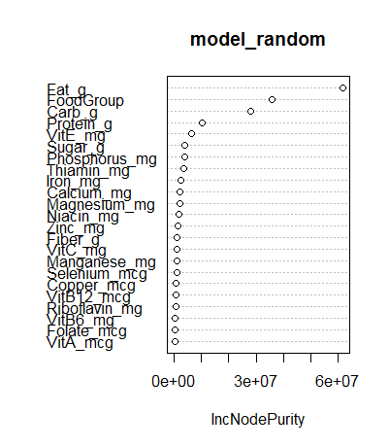
Random Forest
Interpretation: From the plot of variable importance we can see that nutrient Fat_g is most important variable to increase the amount of energy whereas VitA_mcg is less important variable to increase the amount of energy.
So we can delete less important variables
to improve model accuracy.
After deleting less important variableswe get less MSE i.e 333.5755 as we have previous MSE as 381.9992
Here RMSE of the random forest model is 18.26405 , we will try to improve RMSE using Support Vector Regression model.

Slide 12
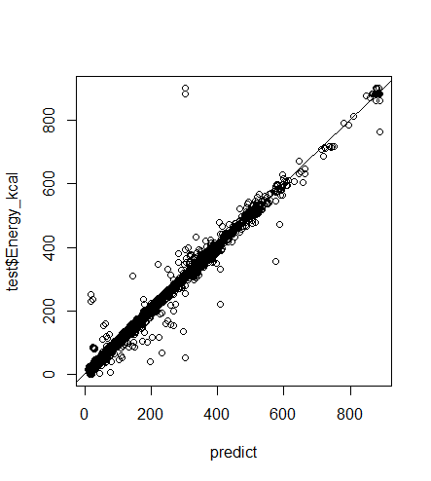
SUPPORT VECTOR REGRESSION
From the above plot of actual versus predicted values for SVR we can see that most of the points are along straight line hence model is good fit for the data.
MSE of the SVR model is 427.5244 and RMSE of the model is 20.6766 which is larger as compared to multiple regression and random forest model so we can say that SVR model is not good fit for the data.

Slide 13
Comparison Of The Models
Model | MSE | RMSE
Model | MSE | RMSE
Multiple Regression | 243.5514 | 15.6061
Random Forest | 333.5755 | 18.2645
Support Vector Regression | 427.5244 | 20.6766
Here we compared the RMSE of the Support Vector Regression, Multiple regression and random forest model, since we can see that RMSE=20.6766 of SVR model is larger and RMSE=15.60613 is small so we can say that the multiple regression model is good fit for the data.

Slide 14
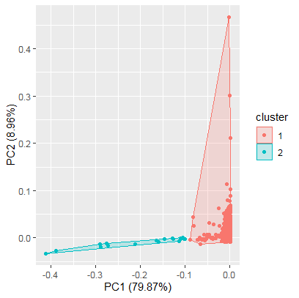
K- Means Clustering
From the K-Means Clustering we can conclude that the optimum number of cluster are 2.So further we can execute the K-means cluster analysis with K=2.
Interpretation: From the above plot we can see that all the observations in the data are categorized into the two clusters, Here the red dots are those observations that belongs to cluster 1 while blue dots are the remaining observations that belongs to cluster 2. Here both the cluster are distinct, it seems to be no overlapping hence we can say that the cluster analysis has been successfully deployed. Also PC1 gives us 79.87% of information and PC2 gives 8.96% of information.

Slide 15
OVERALL CONCLUSION
From Data Visualization: From Bar Plot of Food groups and Fat_g, we can conclude that the food group Fats and Oils contains more amount of Fat_g and food group Fruits and Fruits product provides less amount of Fat_g.From Bar Plot of Food groups and Energy_kcal, we can conclude that food group Fats and oils contains more amount of Energy_kcal.From Pie Chart of Food groups and Protein_g , we can conclude that Food gropu Beef Product provides more amount of Protein_g as compared to other food groups which is 23%.
From Model Fitting:
By comparing all the models we have Multiple Regression gives more accurate results than other models.
Food Groups Beverages,Breakfast cereals, Fats and oils, Fruits and Fruit Juices, Nut and seed Products, Soups Sauces and gravies, Sweets and vegetable and vegetable products are significant that means they are important to increase the amount of Energy.
And nutrients,
Protein_g,Fat_g,Carb_g,Fiber_g,VitB6_mg,VitC_mg,Folate_mcg,Copper_mcg,Magnesium_mg,Manganese_mg,Phosphorus_mg are important to increase the amount of Energy_kcal.
MSE= 243.5514 and RMSE= 15.6061 which is less, i.e. our error interval is between (-15.6061,+15.6061) so our predicted values are between this interval.

Slide 16
Limitations
The study should be for sample size 206856
The data taken for analysis is secondary data .
Data is of only one specific area, if we study different areas then our results may be different.
FUTURE SCOPE
From this project work we can see that Nutrient Fat_g is most important variable to increase the amount of Energy_kcal, and oily products gives us more amount of Fat_g .Also food group Beef Products contains more amount of protein and Fats and oils contains more amount of Energy_kcal. So if we include this type of food products in our daily diet that can help us to maintain our health good. Also here we can also have the information about which food group contain which type of Nutrient that helps us in daily diet.

Slide 17


